Slide 2
Chapter 1: Introduction
Part A: Core Concepts
Part B: The Practicalities
Rationale, Scope and Background of Cultural Risk Assessment and CIERA
Chapter 2:
Chapter 8:
Cultural Risk Assessment & The Cultural Inclusivity and Equity Risk Assessment (CIERA)
Chapter 3: Cultural Risk – EEDI and Bias
Activating Theory -
England and Wales Cricket Board
Chapter 9:
Chapter 4: The Science of Inclusion and Bias
Managing Organisational Risk: Integrating Cultural Risk Awareness into Corporate Governance
Chapter 10:
Chapter 5: Culture
Chapter 11:
Comparing faith in cultural contexts: In Sacred Spaces and on the Dancefloor
Chapter 6: Theories and Frameworks
Chapter 12:
Activating Theory - Action Research with Faith Leaders for the British Ritual Innovation in COVID
Chapter 7: Cultural Intelligence (CQ)
Chapter 13:
Between the lines -
Conversations in Context, a Dialogical Approach
Part C: Case Studies
CS 1: Sweden – Religious Heritage
CS 10: UK – Faith and Sexuality
CS 2: UK – Sensory Rooms
CS 6: Qatar – Football World Cup
CS 11: UK – Cultural Events
CS 3: England – Prom Events
CS 7: USA – NFL
CS 12: USA – Belonging and Ethnicity
CS 4: UAE – Cultural Awareness
CS 8: Japan – Cultural Heritage
CS 13: Caribbean – Diaspora Communities
CS 5: Australia – Indigenous Communities
CS 9: UK – Sport and Gender
CS 14: Nigeria – Business Events

Slide 3
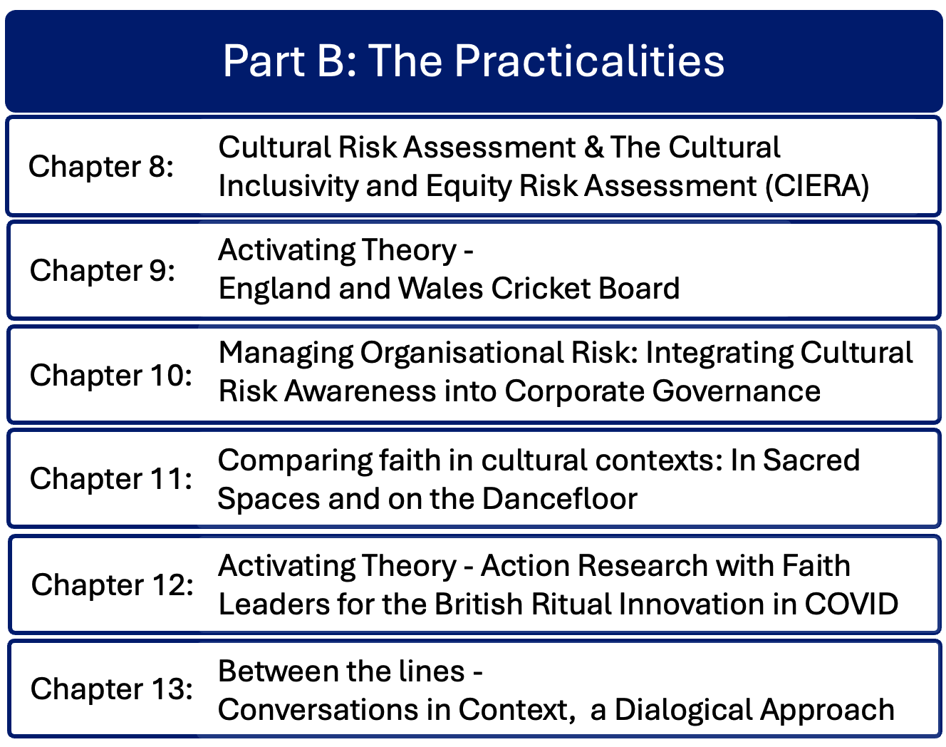

Slide 4
Chapter 12: Activating theory – Action research with faith leaders for the British Ritual Innovation under COVID-19 project.
Ruth Dowson & Bernadette Albert
Explores significant strides in creating inclusive and equitable spaces within faith-related contexts through the British Ritual Innovation under Covid-19 (BRIC-19) project.
Delves into how British faith communities adapted their worship practices during the pandemic, emphasizing the necessity of equitable spaces for diverse groups.
Addresses diverse needs of different communities to create welcoming and inclusive spaces where event creators and planners provide inclusive event spaces to meet ethical, moral, and legal obligations for equality, diversity, and inclusion.

Slide 5
Introduction
Research into ways British faith communities adapted worship practices during the pandemic
Interviews with faith leaders to identify innovations to create more equitable spaces
Importance of teaching students (e.g. in events management) about diverse faith communities and their needs to enable creation of welcoming event spaces

Slide 6
British Ritual Innovation under Covid-19
Within AHRC-funded BRIC-19 project – action learning set
BRIC-19 project examined adaptations in religious practices under pandemic restrictions
Pandemic affected regular worship activities and rites of passage
Outcomes of Dowson & Albert action learning research:
  Understanding people’s lived experience navigating cultural spaces
  Support EEDI planning and provision in religious and faith-related spaces
  Develop Cultural Risk Assessment processes to create policy, procedures and guidelines for faith organizations

Slide 7
Contribution of teaching
Teaching Celebration Ritual and Culture module led to awareness of students’ and event managers’ need for cultural capital on religious practices
Action learning set research through qualitative semi-structured interviews
Assessing delivery of ritual, variations, modifications and innovations
Assessing impacts of cultural wealth and cultural capital
Introducing the Cultural Risk Assessment elements
Identifying existing policies to enhance cultural equity in faith and secular spaces

Slide 8
Learning from interviews with faith leaders
Thematic analysis
  Values and characteristics of individual leaders influence strategic direction of the community
  Interfaith activities foster inclusivity and building relational capital
  Event Content can facilitate cultural exchange
  Accessibility guidelines for in-person in physical spaces and online

Slide 9
Working with students in their faith contexts
Student research into their own faith community is a rich source for dissertation students
Example of Jewish event Management student – final year dissertation in 2021-22 identified changes in practice for her faith community that has restrictions on the I use of technology on the Sabbath

Slide 10
Impact on CIERA©
Applying conceptual models to real life bridges gaps in theory
Cultural Risk Assessment theory developed processes that led to CIERA©
Consistent feedback and review loops to make improvements to models and practice
Race, ethnicity and religious needs should be considered in the creation of welcoming spaces for events

Slide 11
Summary
BRIC-19 project identified some long-term opportunities for faith communities to provide access for worshippers to participate when unable to attend in person
Severe limitations to worship – more complex in some religions
Pandemic disruption to usual practices enabled people to choose different options, which still continues
Research identified insights into creating more inclusive physical and online spaces, enhanced CRA process
Importance of personal and shared communal values in shaping practice

Slide 12
Discussion questions
What aspects of cultural risk most surprised you in this chapter?
How could faith organizations benefit from undertaking cultural risk assessments?
What learning can you take from religious events and apply it to secular aspects of events management?
From an event or venue of your choice that you know well, apply the cultural risk elements as listed in the chapter and draw up an action plan.
Identify one additional cultural risk that impacts on an aspect of managing an event.

Slide 13
Chapter 13: Between the lines –
Conversations in context – a dialogical exploration.
Bernadette Albert & Alister Albert
A dialogical chapter in which author Bernadette Albert is interviewed by Alister Albert (a renowned NBA analyst, basketball commentator, actor, and business process analyst).
Discussing cultural risk issues and the future of assessing and managing cultural risk, Bernadette considers some of the issues around application of the Cultural Risk Assessment.
A longer version of the interview is available as an online video resource.

Slide 14
Introducing the book
Wealth of practitioner and academic (“pracademic”) experience of authors
Aimed for user-friendly practical approach, a portable resource
For event professionals, early career practitioners and event management students
Applicable across multiple sectors, and beyond events

Slide 15
The Cultural Risk Assessment Tool
Book structure – 3 parts
Designed to enable event planners and venue managers to create more welcoming spaces and events
Easy to apply learning from the book to onsite application of CRA
Academic concept development
Application of theory to real life
Case studies by international authors – practitioners and academics

Slide 16
The CIERA
Applications
Cultural Inclusivity and Equity Risk Assessment
Considers equity in context
Enabling diverse users to navigate spaces in an inclusive way
The superdiverse world requires processes to identify different characteristics
Needs can be accommodated before arriving in the space
Enables identification of cultural risks to minimise psychological, practical and emotional risks for all participants

Slide 17
Broader application
CRA development
Working onsite in people’s homes – understanding cultural backgrounds
Corporate world – engaging with others from different cultural backgrounds
From teaching, then applied in corporate business sector
CIERA© applies principles and concepts to the whole organization, not just the event space; assesses its cultural position, inclusivity and diversity to enable strategic organizational development

Slide 18
Cultural capital in context
Skills required
Individuals possess cultural capital based on life experience and context
Cultural knowledge has value – this can be developed into deeper cultural capital
Developing cultural intelligence is ongoing as cultures change
21 dimensions (umbrella) across 4 strands
Cognitive, metacognitive, motivational, behavioural
Need to practice flexibility

Slide 19
Challenges
Current political climate
Aim to include all, not include some at the expense of excluding others
Recognise systemic failures that create current environments

Slide 20
Reflections – questions for discussion
Reflecting on the contents of the transcript and the challenges of systemic change, write down three actions that you can undertake to support the development of your own cultural competence and intelligence and work towards delivering more inclusive spaces.
Discuss the motivation of the authors for writing this book and developing the CRA and the CIERA©, and how event professionals can use this problem-solving strategy in their careers.
How do you think the authors’ careers as event managers and academics has influenced the way that they designed the tools and content of this book? Consider how being event practitioners have influenced the design and applicability of the tools provided.

